Slide 1

GAYAT
GAYATRI VIDYA PARISHAD COLLEGE OF ENGINEERING FOR WOMEN
WOMEN EMPOWERMENT IN MODERN SOCIETY
NAME:M DAKSHAYANI
ROLL NO: 325103210135
BRANCH:CSE-3

Slide 2

WOMEN EMPOWERMENT IN MODERN SOCIETY
Introduction :
Women empowerment = increasing women’s ability to control their lives.
Focuses on equality, rights, education, decision-making, and economic independence.
Crucial for social, economic, and political development.

Slide 3

Importance of Women Empowerment
Strengthens economies and reduces poverty.
Promotes gender equality.
Enhances community health and education.
Ensures inclusive and sustainable development.

Slide 4
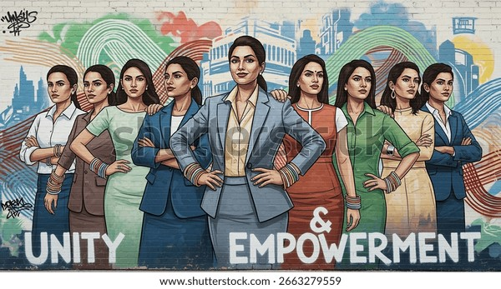
KEY AREA OF EMPOWERMENT
Education empowerment
Economic empowerment
Political empowerment
Social empowerment
Legal empowerment

Slide 5

ROLE OF TECHNOLOGY
Digital literacy programs for women.
Online job opportunities and remote work.
Women in STEM fields.
Social media as a platform for awareness and advocacy

Slide 6
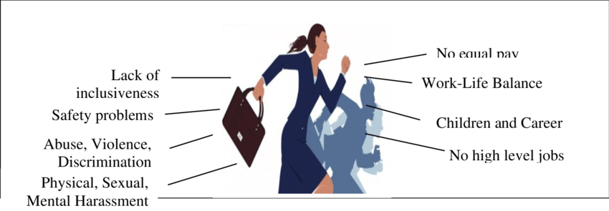
Challenges to Women Empowerment :
1.Gender discrimination and stereotypes.
2.Violence and harassment.
3.Unequal access to education and healthcare.
4.Wage gap and economic inequality.
5.Cultural and social barriers.

Slide 7


Slide 8
Successful stories of women

